Slide 1
Ground to Cloud: Your Migration Success Checklist
Matt Gordon
SQLBits – March 17, 2023

Slide 2

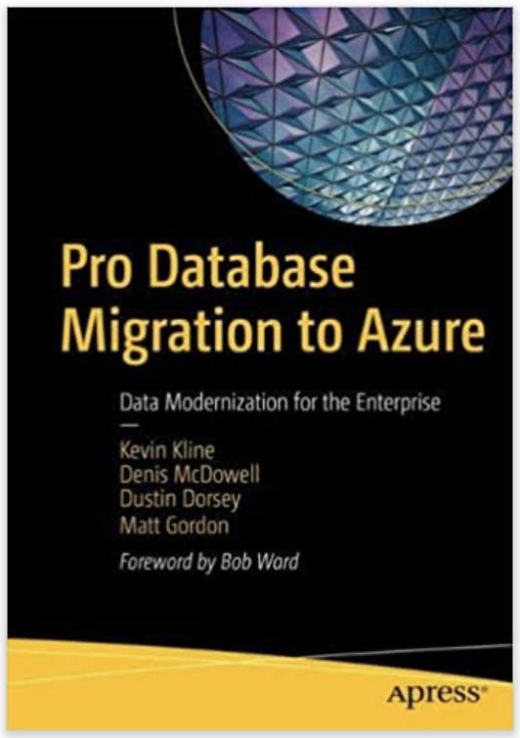
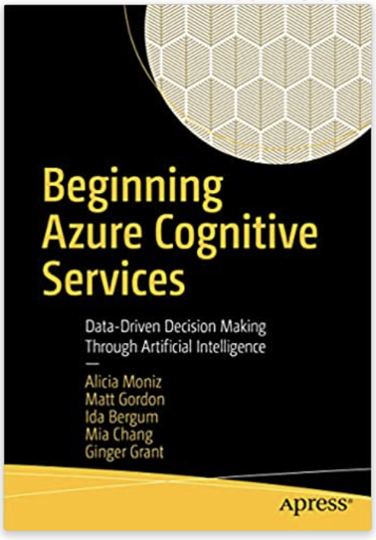
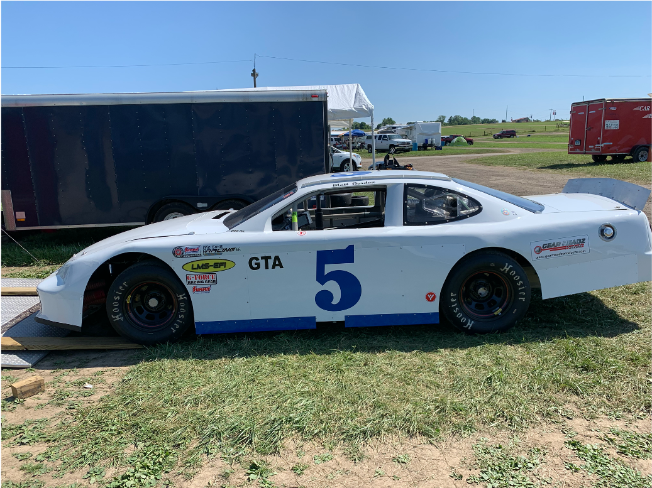

Matt Gordon
Senior Azure Architect
matt@sqlatspeed.com
: @sqlatspeed
www.sqlatspeed.com

Slide 3


About Me
20+ years of SQL Server experience
Microsoft Data Platform MVP
Friend of Redgate
Managed 24x7 datacenters, DBA teams, and cloud teams
Led cloud migrations large and small
Leader of Lexington, KY (USA) Data Technology Group

Slide 4

Session Feedback
https://sqlb.it/?9651

Slide 5

What Are We Migrating?
Data (what kind of data?)
Apps
Servers
Direct network connections
Other oddball entities

Slide 6

Why Are We Migrating Things?
Trying to save money?
Closing/consolidating datacenters?
Boss person/people are making us
Extending support for legacy environments (Azure only)?
Notes:
Remember that the motivation guides our technical decisions
Windows Server 2012 extended support ends 10/10 this year

Slide 7

Who Do We Need To Do The Work?
Networking knowledge critical
Operations people
Security people
Application developers/directors
Data people
Consultants/partners?
Notes:
Reminder that teams (especially your team) cannot do two jobs at once and you shouldn’t make them
Remember that you are very, VERY likely to be keeping the majority of two production-level environments running in parallel

Slide 8
Where Is Our Stuff Going?
Which cloud?
IaaS? PaaS? A blend of the two?
Not sure what I mean?
Notes:
Talk about how companies may have existing cloud relationships
Note Azure cost benefits like Azure hybrid benefit but note that companies often have their own cloud relationships before these projects

Slide 9
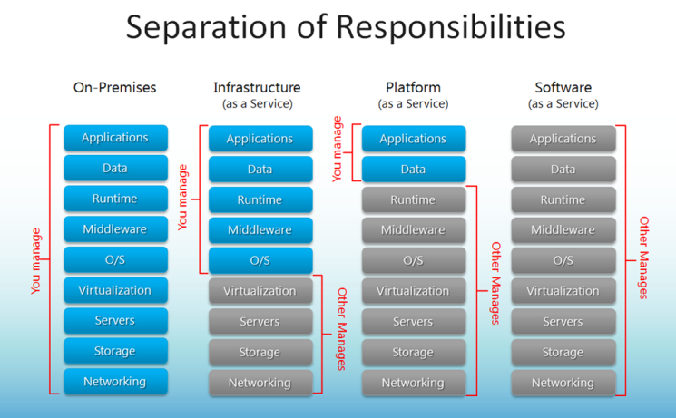
Breaking Down The Cloud’s Alphabet Soup

Slide 10
We Chose a Cloud…Now What?
Azure | Amazon | Google
Azure VM | Amazon EC2 | Google Compute Engine
Azure SQL DB | Amazon RDS | Cloud SQL
Azure VM vs Amazon EC2 vs Google Compute Engine
Azure SQL Database vs Amazon RDS vs Cloud SQL
Azure migration tooling > AWS > GCP
Remember skills/experience of the teams involved matter here
Notes:
Focusing on relational databases here because cloud-based EDWs are often rebuild projects versus migration projects…if that’s not the case for you let’s talk

Slide 11
If We Chose Azure…What Are Our Choices?
Azure SQL
Azure SQL Managed Instance
General Purpose vs Business Critical service tiers
Hyperscale?
Serverless?
Serverless Hyperscale?
Notes:
Remember the time zone note for Azure SQL MI
Talk about co-located compute/storage in BC vs that not being in GP (note AG-related architecture under BC as well and AG-ish in GP)

Slide 12
So Many Choices…How Do I Pick?
RTO/RPO?
What are our SLAs?
What is our budget?
Database Migration Assistant (DMA)
Azure SQL SKU recommendation within DMA
Notes:
Remember the time zone note for Azure SQL MI
Note some specialized tooling in Azure Migrate for VMWare SQL Server environments

Slide 13

Have We Tested It?
Don’t just assume it will work
Can fix anything in the cloud with $$$ (almost)
Do we have any baseline information about performance?
Do we know how we’re going to evaluate performance and monitor it?
DMA SKU recommendations can help here
WorkloadTools (Gianluca Sartori, @spaghettidba) can be a great community resource

Slide 14
How Are We Migrating?
Azure Migrate
Amazon DMS
GCP “tooling”

Slide 15

How Are We Migrating It (details…)?
Replication to Azure SQL
Replication to SQL Server on Azure VM
Log shipping to SQL Server on Azure VM
Export data-tier application in SSMS and save to Azure
Smart Bulk Copy tool
Azure Data Studio migration extension

Slide 16

How Are We Migrating (MI-specific?)
Log Replay Service
Managed Instance Link
Backup and restore
Azure Data Studio migration extension
Notes:
MI link is only one way in SQL 2016 and SQL 2019 and does not require an AG

Slide 17

When Are We Migrating?
Set firm dates
Overcommunicate (especially externally)
Remember internal processes (end of month, end of quarter, etc.)
Take note of client/external processes
Adjust for people’s personal schedules and recovery time

Slide 18

Who Is Doing The Migrating?
Practice makes perfect
Put a migration team together
Plan for problems
Plan the problem response and practice it
Prepare for rollback(s)

Slide 19

Politics and Protection
Cloud spend will often be pinned on data/infra teams
Set expectations clearly throughout the project
Understand that “we’ll fix our code when we’re in the cloud” pretty much never happens
Communicate development delays/obstacles throughout

Slide 20

Our Checklist
What Is Moving?
Why?
Who Do We Need?
Where Is It Going?
Has It Been Tested?

Slide 21
Our Checklist
How Are We Moving It?
When Are We Moving It?
Who Is Moving It?
Is The Team Protected?

Slide 22
The Slide Where I Sell My Books
Cognitive Services book
Database migration book
Notes:
Mention chapter 2 for some different takes on a checklist

Slide 23
Session Feedback
https://sqlb.it/?9651

Slide 24
Thanks For Attending!
Matt Gordon
Senior Azure Architect
matt@sqlatspeed.com
: @sqlatspeed
www.sqlatspeed.com
https://github.com/sqlatspeed/2023_presentations

Slide 25
Resources
Microsoft Ground to Cloud Workshop
Creating Your First Azure SQL Database
SQL Server 2008 Extended Support
Running Data Migration Assistant Enterprise-Wide
Smart Bulk Copy
Azure Data Studio Migration Extension
Azure SQL SKU recommendations
WorkloadTools GitHub repo

